Slide 1
Take Control of the Data of You
Nigel Parker @nzigel
Principal Software Engineer
Microsoft ASIA

Slide 2

Notes:
In the next hour I’m going to let you in on a little secret

Slide 4


Slide 5
A close up of a water fountain (very low confidence)

Slide 6

Notes:
A close up of some grass

Slide 7
A picture containing sky (high confidence)

Slide 8
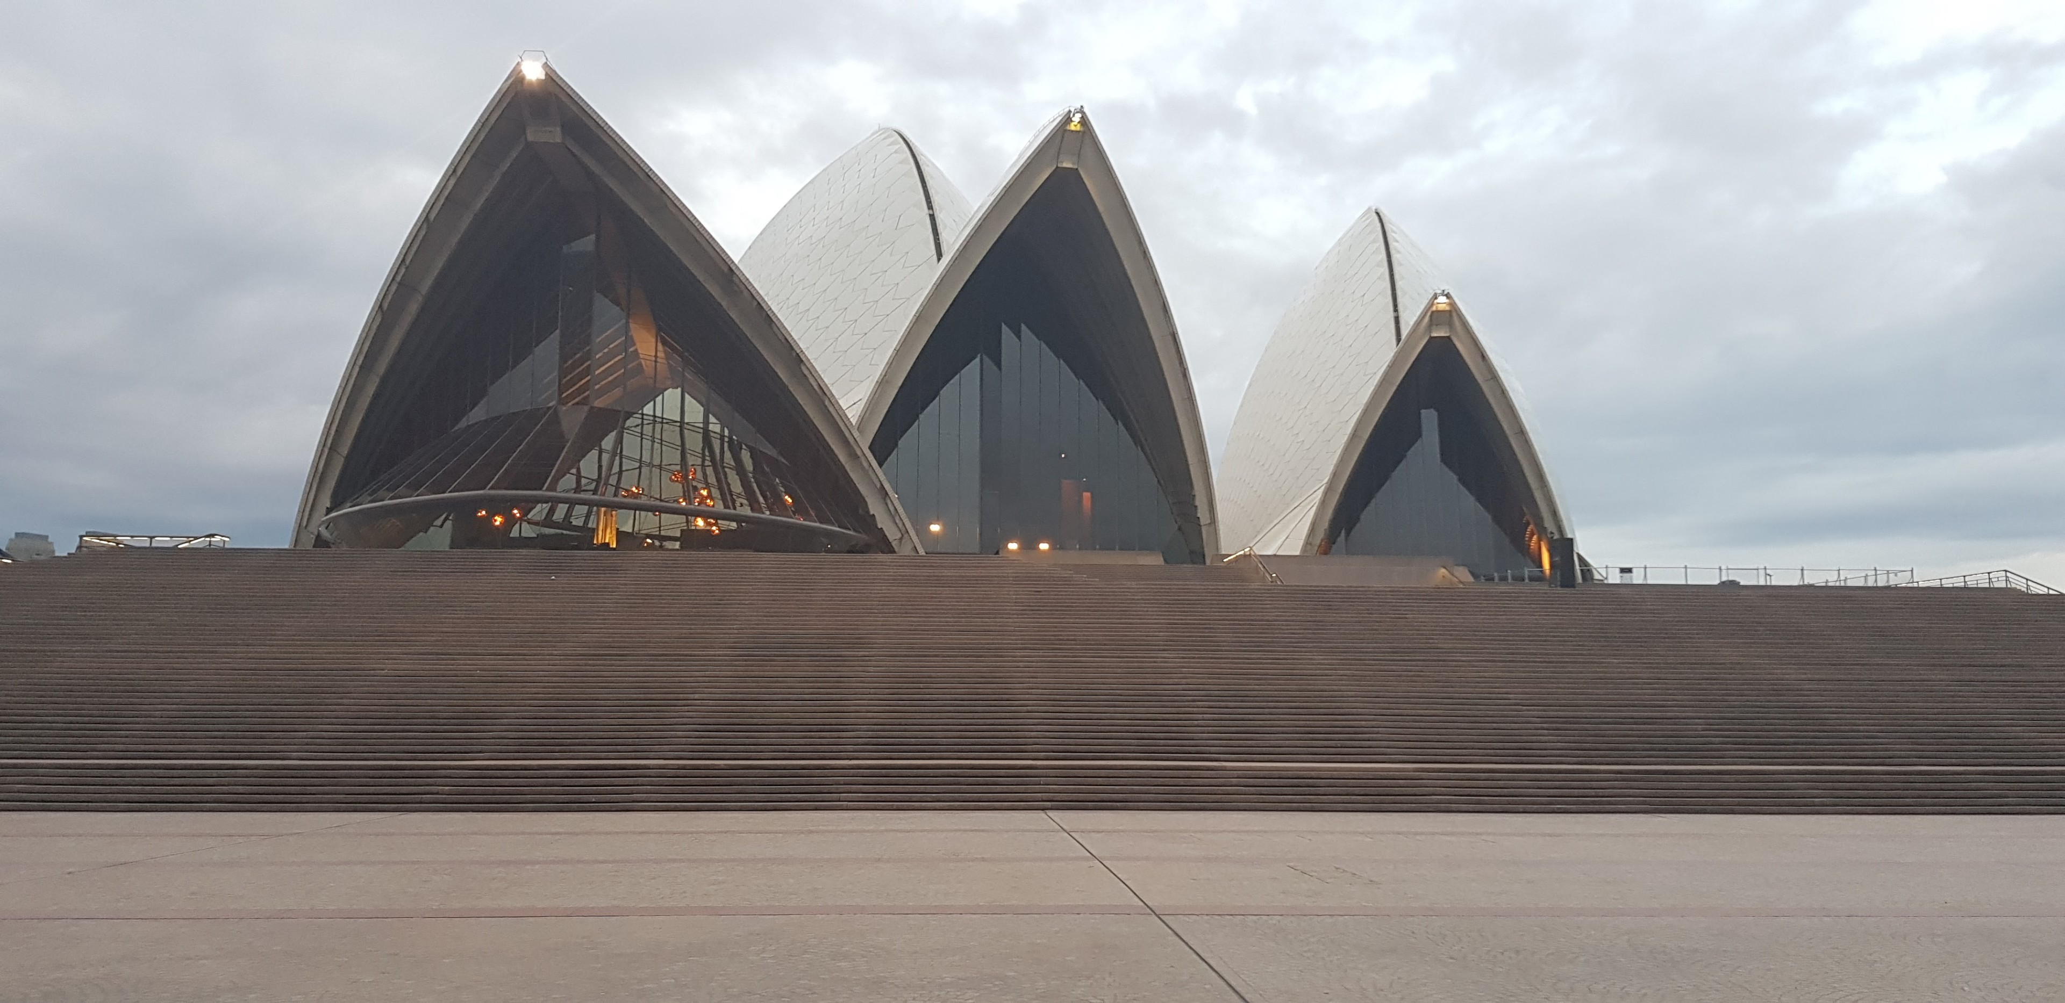
Notes:
A large white building

Slide 9
A large white building (high confidence)
Notes:
A large white building

Slide 10
The Sydney Opera House
Notes:
A large white building

Slide 11
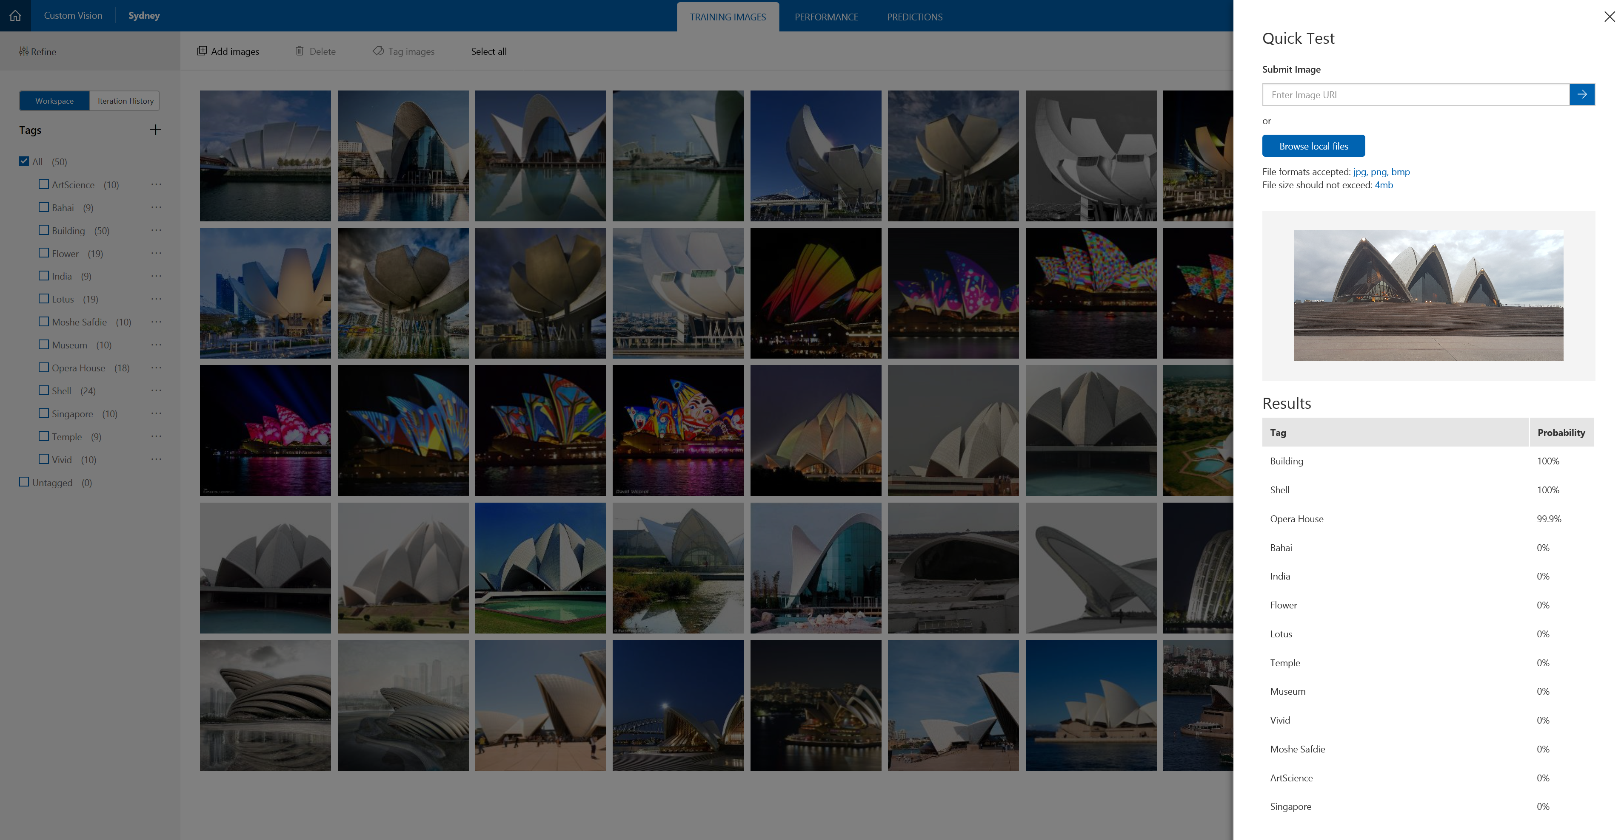

Slide 12
human + machines
Notes:
We don’t get to choose when and where technological progress starts and stops, we can’t slow down in fact we have to speed up.

Slide 13
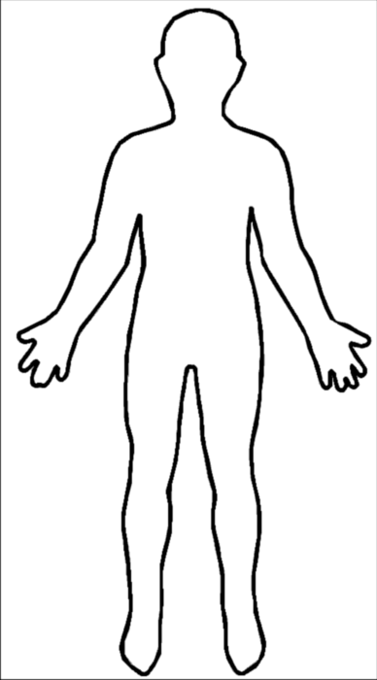
understanding
purpose
passion

Slide 14
understanding
purpose
passion

Slide 15
understanding
purpose
passion

Slide 16
human + machines
Notes:
We don’t get to choose when and where technological progress starts and stops, we can’t slow down in fact we have to speed up.

Slide 17
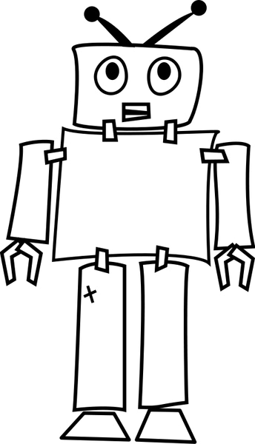
calculations
instructions
objectivity

Slide 18
calculations
instructions
objectivity

Slide 19
calculations
instructions
objectivity

Slide 20
human + machines
Notes:
We don’t get to choose when and where technological progress starts and stops, we can’t slow down in fact we have to speed up.

Slide 21
novice + machines + better process

Slide 22
expert + machines + inferior process
>
Notes:
Winners not grandmasters or super computers winners were a pair of amateurs operating three ordinary PC’s at the same time.

Slide 23
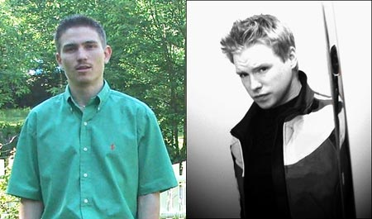
Zack Stephen
Steven Cramton
Notes:
In 2005, an advanced chess tournament took place that allowed any combination of humans and computers. Steven Cramton and Zackary Stephen, who only held novice status in Elo (named after physics professor Arpad Elo) chess rankings, took their regular desktop computers and squeezed them for their purposes. They won that tournament against chess masters with superior chess ratings and even superior hardware and software. Both players had leveraged their expertise to align computing power to win chess games. They created a superior team comprising humans and machines. In essence, a new form of chess intelligence had emerged. Kasparov concluded, “Human strategic guidance combined with the tactical acuity of a computer was overwhelming.”
Hardware
1. Dell Pentium 4 @2.8 GHz 512MB RAM 2. Dell Pentium 3 @1.6 GHz 256MB RAM 3. AMD 3200+
ZackS consisted of a team of two players from New Hampshire: Steven Cramton, 1685 USCF and Zackary Stephen, 1398 USCF. They used three computers for the event, an AMD 3200+, a 2.8 MHz and a 1.6 MHz Pentium. The ZackS team used the chess engines Fritz, Shredder, Junior and Chess Tiger – no GMs or IMs were involved. ZackS consisted of a team of two players from New Hampshire: Steven Cramton, 1685 USCF and Zackary Stephen, 1398 USCF. They used three computers for the event, an AMD 3200+, a 2.8 MHz and a 1.6 MHz Pentium. The ZackS team used the chess engines Fritz, Shredder, Junior and Chess Tiger – no GMs or IMs were involved.

Slide 24
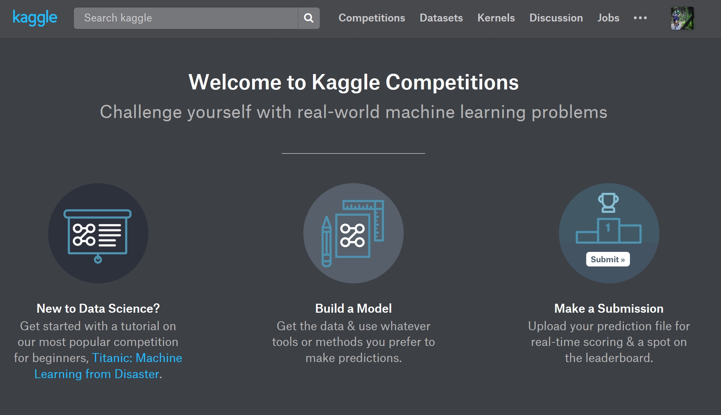

Slide 25

DATA IS THE NEW OIL
Notes:
We have all heard the rally cry that Data is the New Oil and that all software companies are going become data companies but this isn’t new

Slide 26
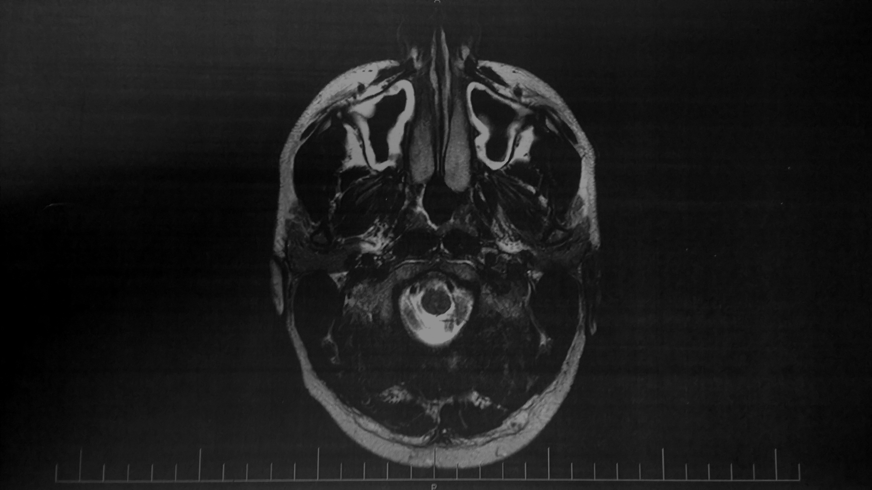

Notes:
I had gained weight, reduced activity, I was eating a bad diet and spending too much time in front of a computer without moving around.
I had developed vertigo that was giving me the feeling of being slightly drunk. This went on for months but medical checks said there was nothing wrong with me.
Something had to change.

Slide 27
something stops
something begins
change
transition
Notes:
The change formula - created by David Gleicher in the early 1960s and refined by Kathie Dannemiller in the 1980s

Slide 28
Dissatisfaction* Vision * First steps > Resistance
The formula for change Kathie Dannemiller – 1980’s
Notes:
The change formula - created by David Gleicher in the early 1960s and refined by Kathie Dannemiller in the 1980s

Slide 29
Dissatisfaction* Vision * First steps > Resistance
Notes:
The change formula

Slide 30


Slide 31
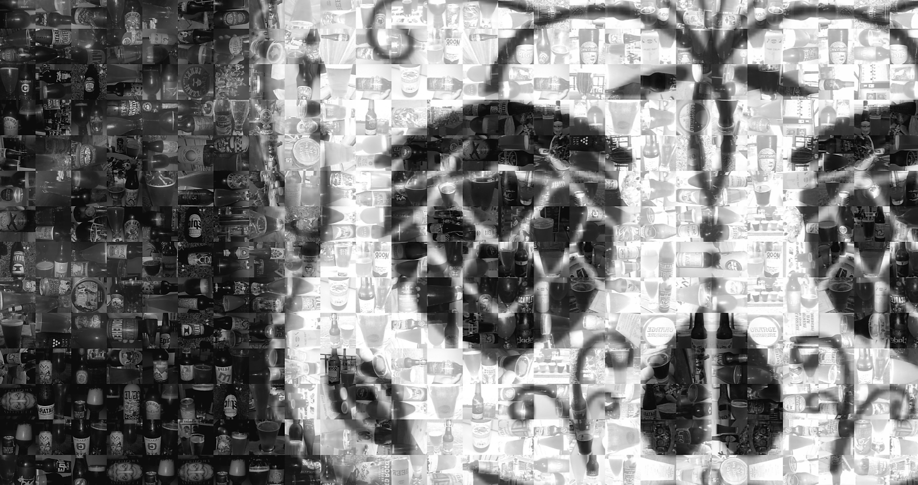

Slide 32


Slide 33
my bad diet and lack of exercise
my love of craft beer
+

Slide 34
my bad diet and lack of exercise
my love of craft beer
+

Slide 35
=
Dissatisfaction* Vision * First steps > Resistance
Notes:
The change formula

Slide 36
=
Dissatisfaction* Vision * First steps > Resistance
Notes:
The change formula

Slide 37

I will walk/run 4,000km in 2014
Notes:
I set this goal for myself the only problem was that I had a resting heart rate over 100 and I hated running.

Slide 38
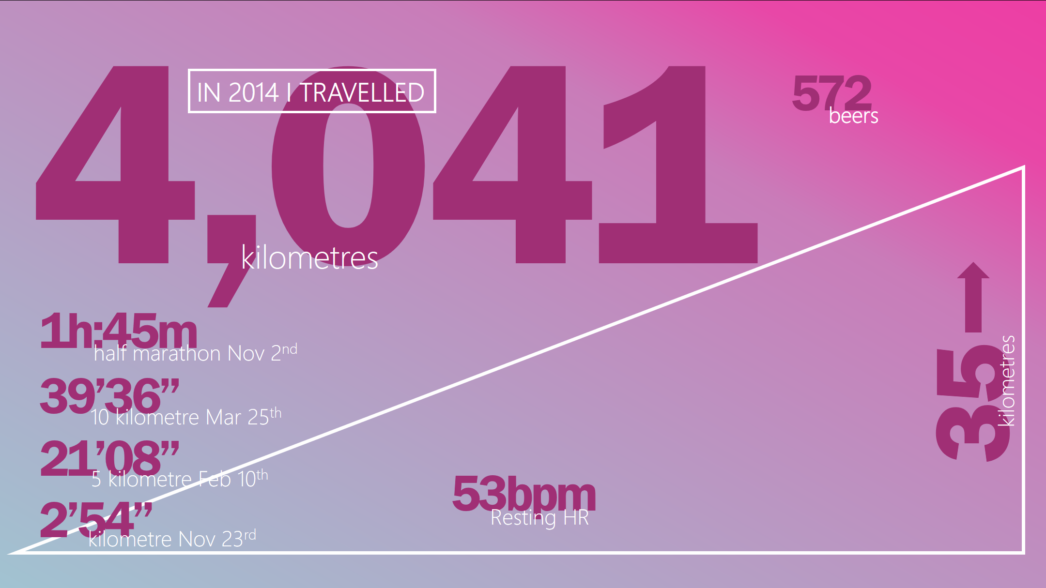

Slide 39
5,106
687
IN 2015 I TRAVELLED
beers
kilometres
4h:10m
3h:38m
Routeburn Classic
April 25th
53
marathon Feb 14th
kilometres
1h:32m
33.2
half marathon July 5th
54.8
19’36”
kilometres
VO2 max
1,859
5 kilometre Oct 10th
43bpm
2’40”
metres gain
Resting HR
143bpm
kilometre Aug 4th

Slide 40
4,621
681
IN 2016 I TRAVELLED
beers
kilometres
3h:22m
marathon Oct 30th
8h:22m
1h:30m
Tarawera Ultra
Feb 6th
53
half marathon Oct 30th
kilometres
38’00”
67.2
56.7
10 kilometre July 14th
kilometres
18’16”
VO2 max
1,561
5 kilometre July 14th
42bpm
3’03”
metres gain
Resting HR
144bpm
Kilometre May 22nd

Slide 41
I will walk/run 4,000km in 2014
Notes:
I set this goal for myself the only problem was that I had a resting heart rate over 100 and I hated running.

Slide 42
=
Dissatisfaction* Vision * First steps > Resistance
Notes:
The change formula

Slide 43
=
Dissatisfaction* Vision * First steps > Resistance
Notes:
The change formula

Slide 44
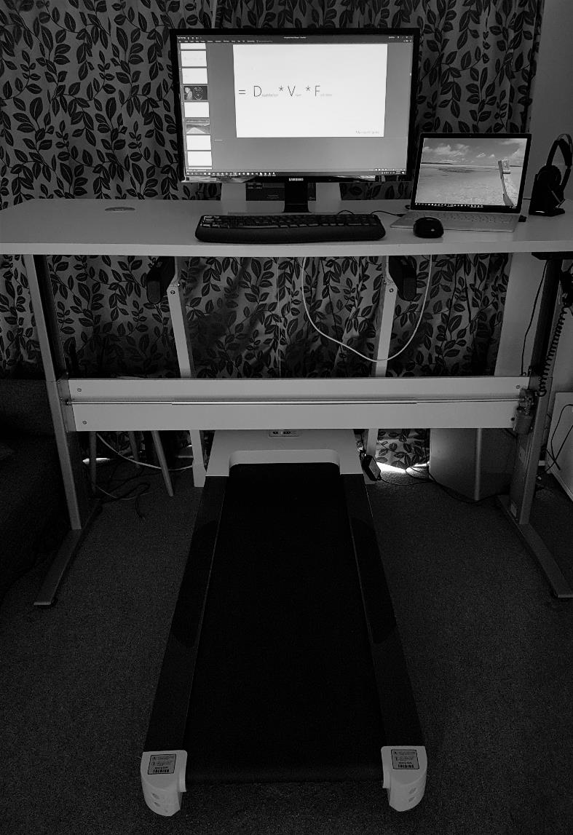
I got myself a treadmill

Slide 45
=
Dissatisfaction* Vision * First steps > Resistance
Notes:
The change formula

Slide 46
=
Dissatisfaction* Vision * First steps > Resistance
Notes:
The change formula

Slide 47

I became allergic to exercise
Notes:
Off the back of over exercising with a virus I developed an immune disease (urticarial) with no known cause or cure

Slide 48
chronic urticaria

Slide 49
I cured myself through insight from data

Slide 50
track everything
learn to breath
learn to eat

Slide 51
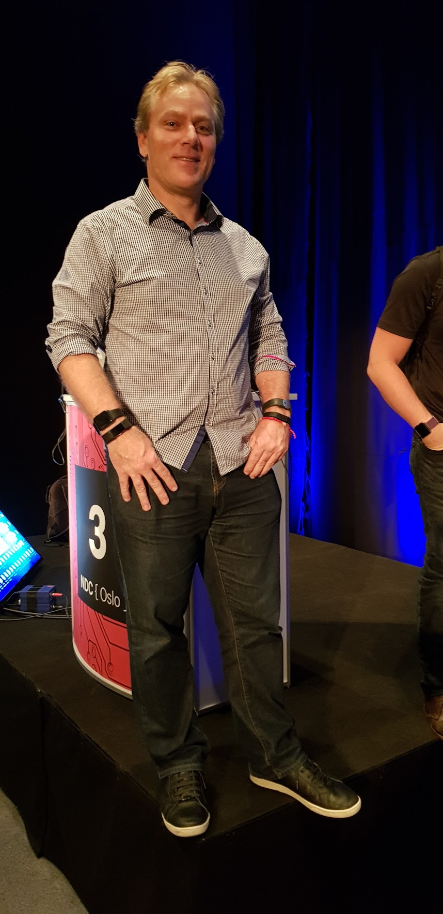

Slide 52
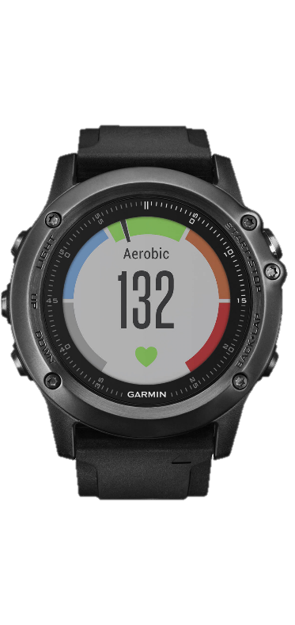
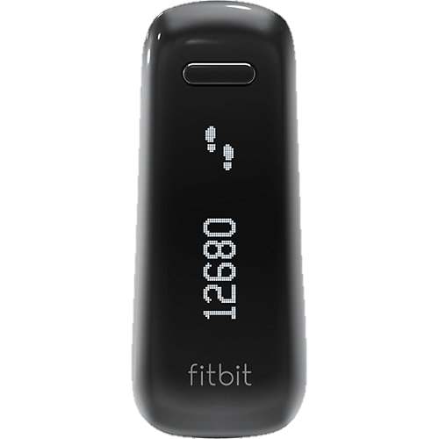
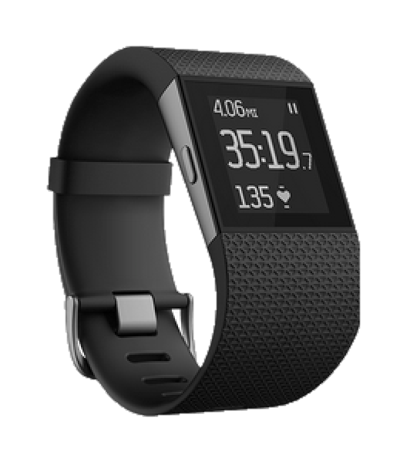
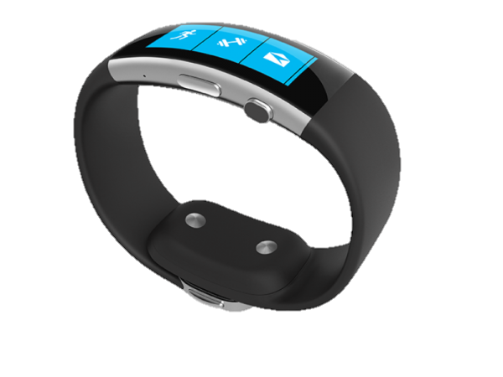
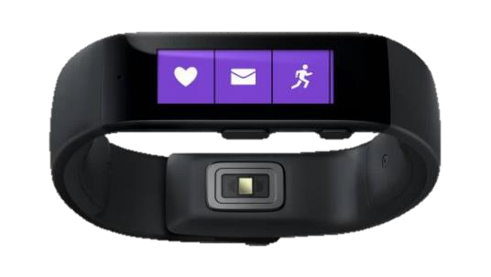
tracker evolution
fitbit one
Microsoft Band
fitbit surge
Microsoft Band 2
fēnix 3 HR
Nov 2012
Oct 2014
Dec 2014
Oct 2015
Feb 2016
Pay to get your data
No heart rate data
Lost data when changing
time zones
Short Battery Life
No Altimeter
GPS challenges
Pay to get your data
No heart rate data exported
Lost data when changing
time zones
Battery Life issues on GPS
Great sleep tracking
Build quality on strap
Waterproof
Altimeter challenges
Good GPS
Great Battery Life

Slide 54
track everything
learn to breath
learn to eat

Slide 55
track everything
learn to breath
learn to eat

Slide 56
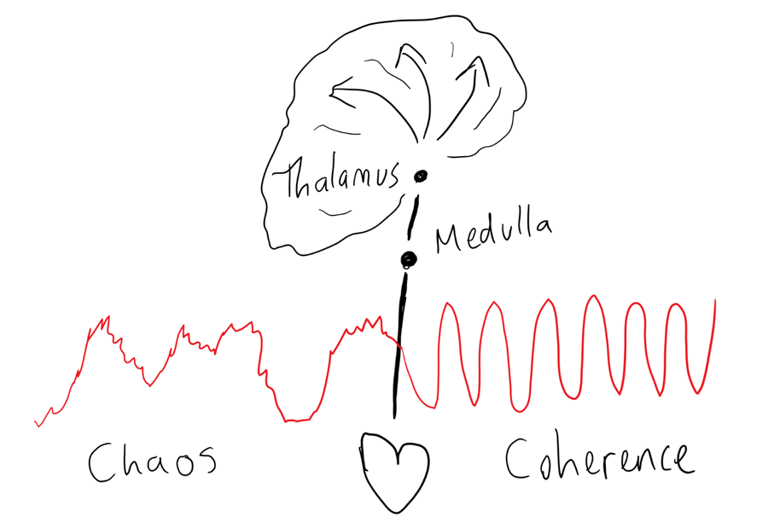
HeartMath Institute
Notes:
Dr Sven Hansen from the Resilience Institute taught me how best to sleep, how to breath and about heart math.
Disordered heart rhythms inhibit our thinking and ordered heart rhythms facilitate our thinking.
Thalamus – synchronizes cortical activity
Medulla – regulates basic life functions.

Slide 57
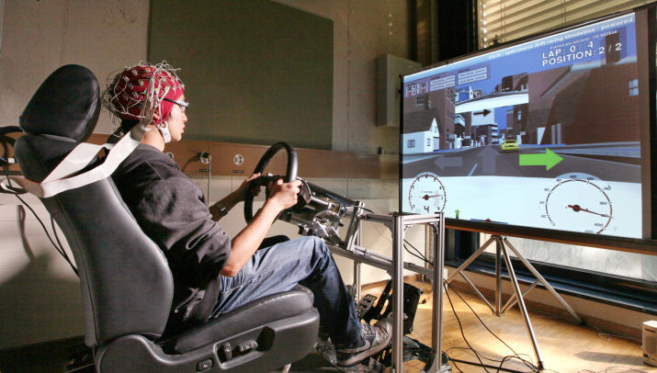
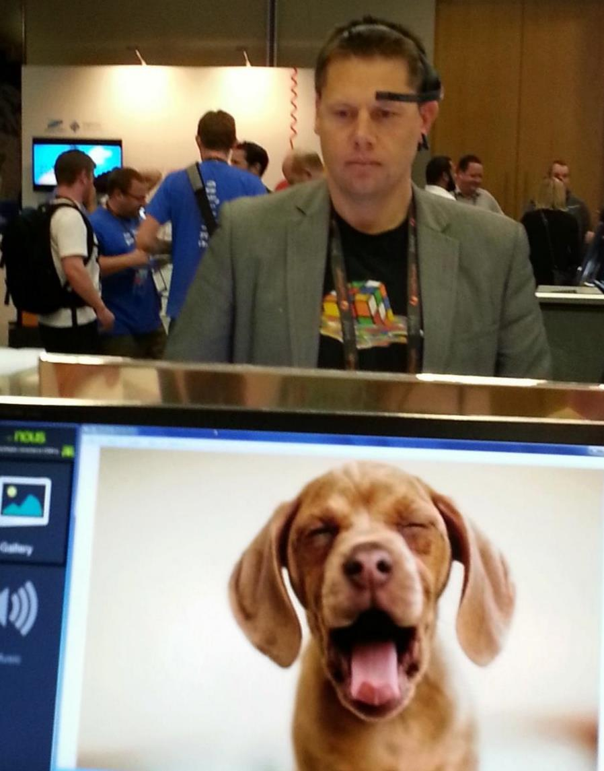
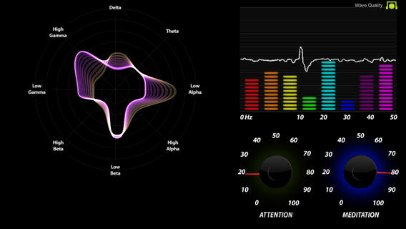
Notes:
I have found that there is a correlation between breathing/ heart math and brain waves.
I use the same breathing techniques to drive attention and meditation as I do to lower my heart rate and drive coherence.

Slide 58
HeartMath Institute
Notes:
Dr Sven Hansen from the Resilience Institute taught me how best to sleep, how to breath and about heart math.
Disordered heart rhythms inhibit our thinking and ordered heart rhythms facilitate our thinking.
Thalamus – synchronizes cortical activity
Medulla – regulates basic life functions.

Slide 59
track everything
learn to breath
learn to eat

Slide 60
track everything
learn to breath
learn to eat

Slide 61
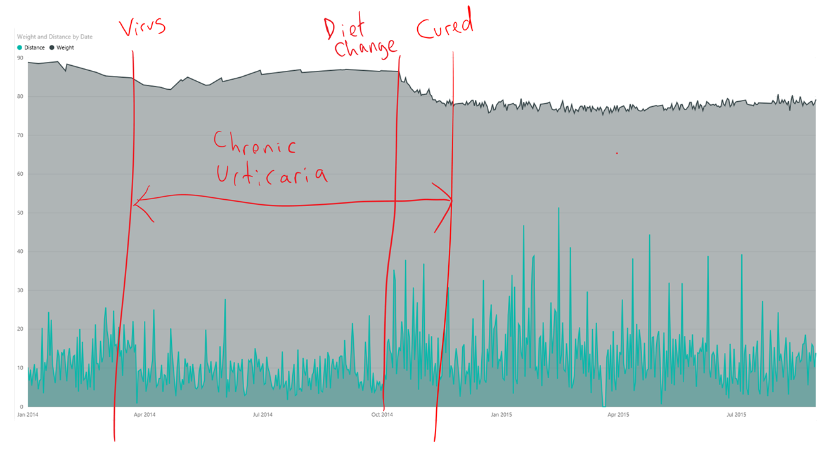
Notes:
I used MyFitnessPal for three months to monitor what I ate

Slide 62
track everything
learn to breath
learn to eat

Slide 63
we are moving from a world of knowing what happened and why it happened

Slide 64
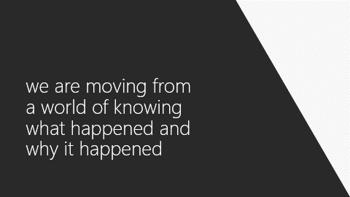
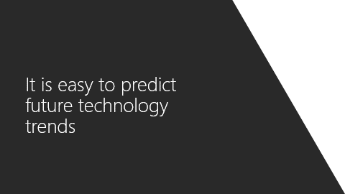

Slide 65
to predicting what is going to happen and what is needed to make it happen

Slide 66
to predicting what is going to happen and what is needed to make it happen

Slide 67
to predicting what is going to happen and what is needed to make it happen
Traditional BI
value
what
happened?
descriptive
analytics
hindsight
difficulty
Source: Gartner

Slide 68
to predicting what is going to happen and what is needed to make it happen
Traditional BI
why did it
happen?
value
diagnostic
analytics
what
happened?
descriptive
analytics
hindsight
difficulty
Source: Gartner

Slide 69
to predicting what is going to happen and what is needed to make it happen
Traditional BI
what will
happen?
predictive
analytics
why did it
happen?
value
diagnostic
analytics
insight
what
happened?
descriptive
analytics
hindsight
Advanced Analytics
difficulty
Source: Gartner

Slide 70
to predicting what is going to happen and what is needed to make it happen
Traditional BI
how can we
make it happen?
prescriptive
analytics
what will
happen?
predictive
analytics
why did it
happen?
foresight
value
diagnostic
analytics
insight
what
happened?
descriptive
analytics
hindsight
Advanced Analytics
difficulty
Source: Gartner

Slide 71
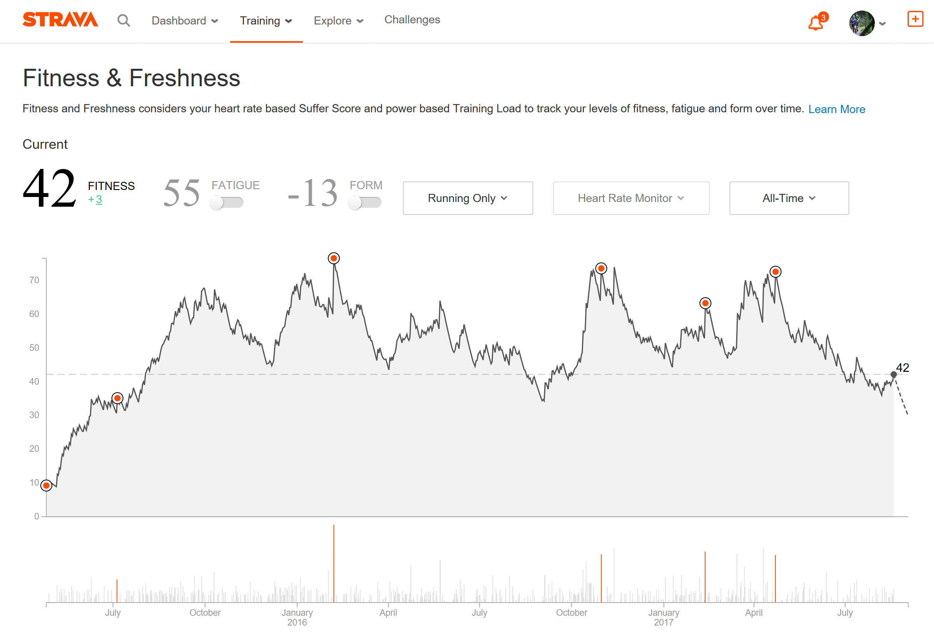

Slide 72
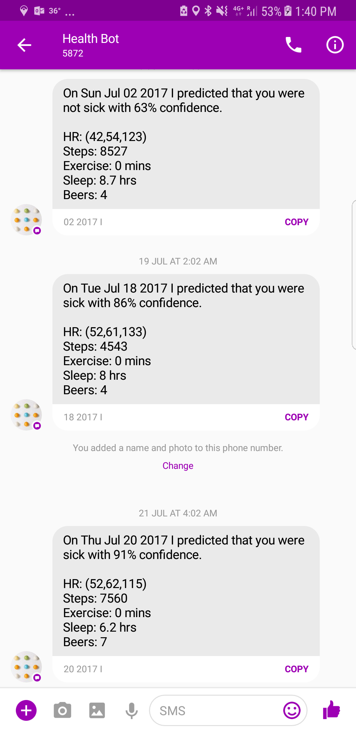
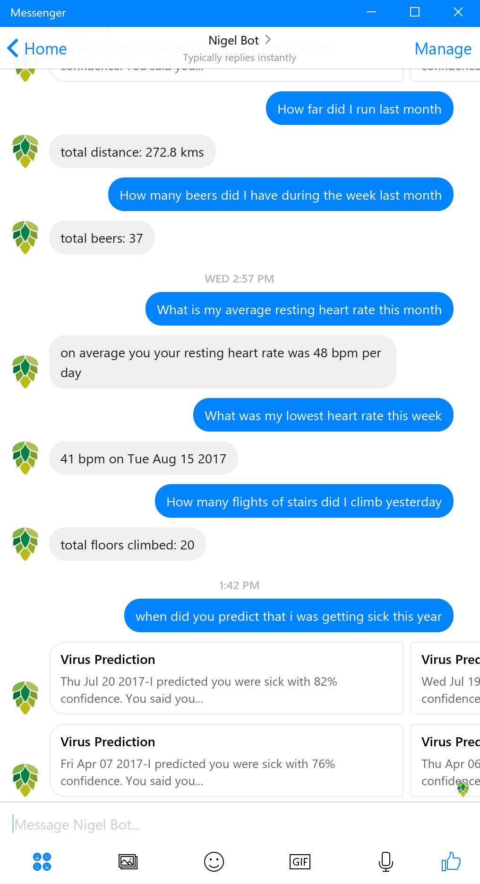

Slide 73


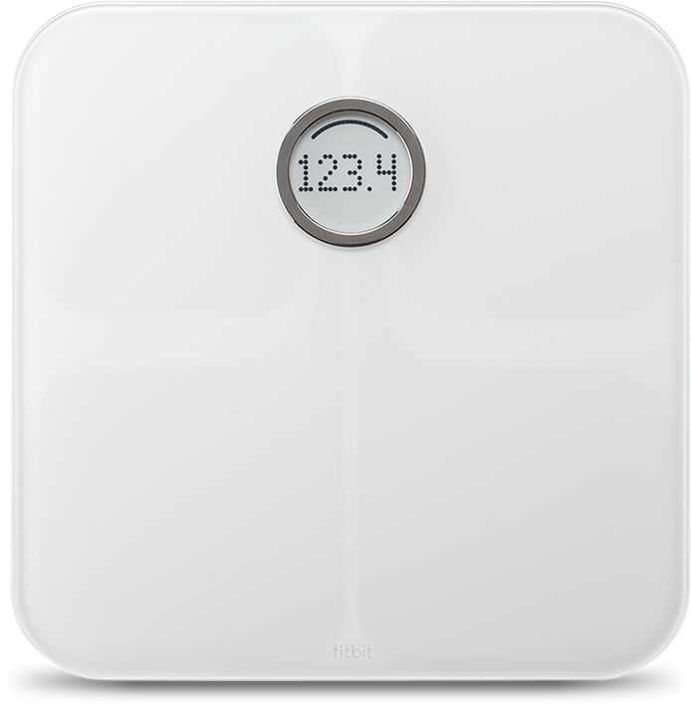

turning data into intelligent action
Information Management
Big Data Stores
Machine Learning and Analytics
Intelligence
fēnix 3 HR
People
Azure
Function
Cosmos
DB
Machine Learning
LUIS
Bot Framework
Latency
Web
aria
Personal Digital Assistant
Mobile
Apps
<10ms
Bots
99th percentile
Dashboards & Visualizations
untappd
Power BI
Automated Systems
Data
Cortana Intelligence Suite
Action

Slide 74
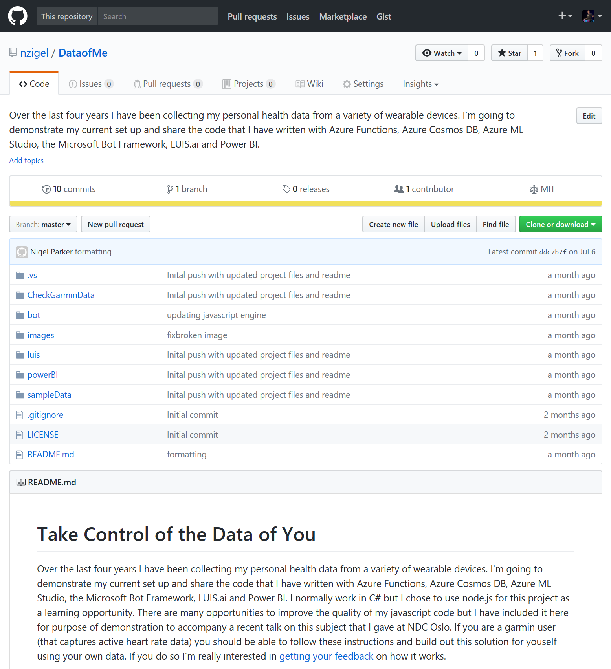

Slide 75
Resources - @nzigel
github.com/nzigel/DataofMe
github.com/ryanvolum/AzureSearchBot
aka.ms/azuremlcheatsheet
bots.botframework.com
luis.ai
aka.ms/botboiler

Slide 76
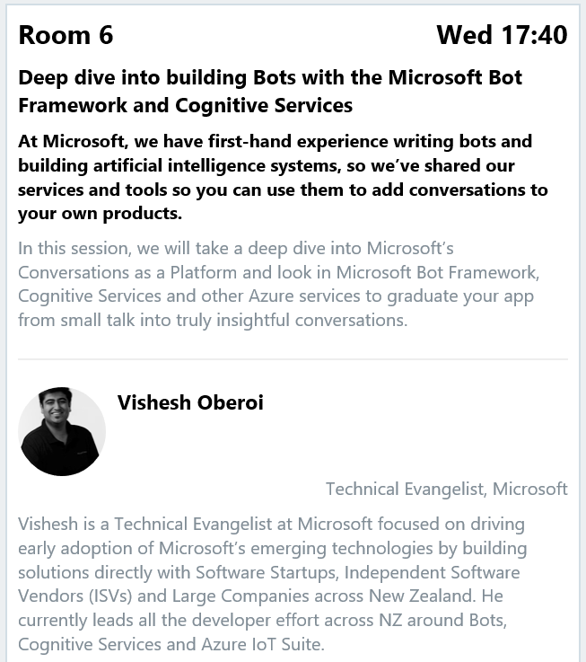
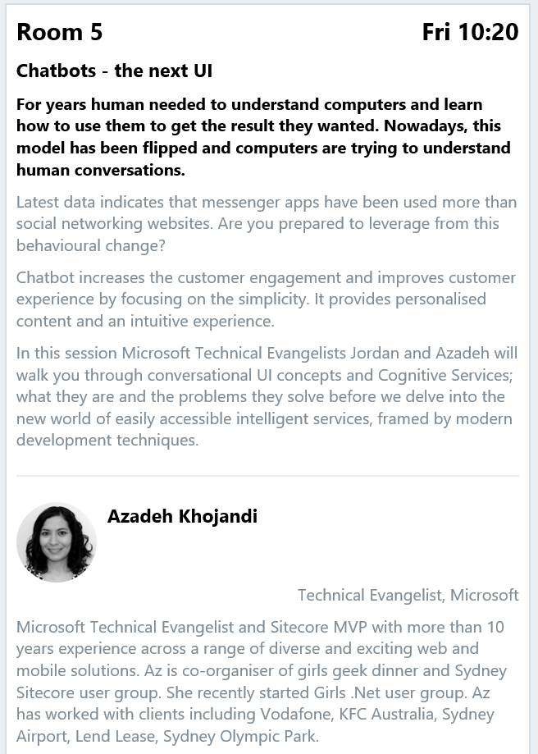

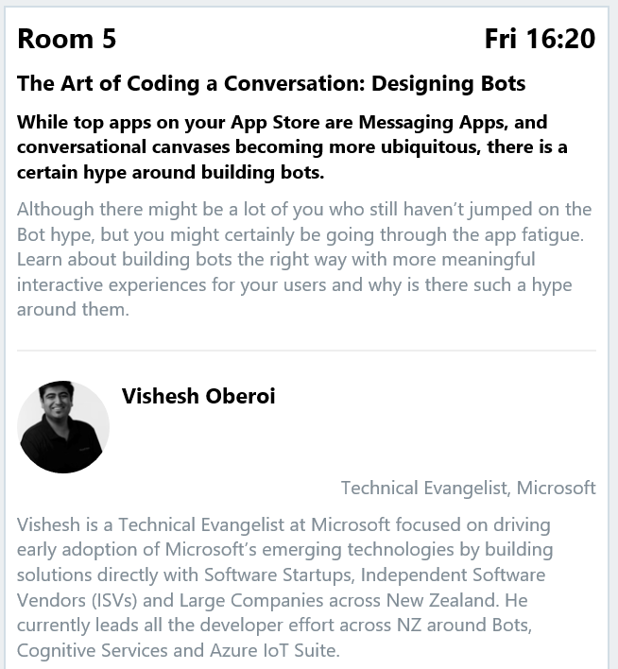
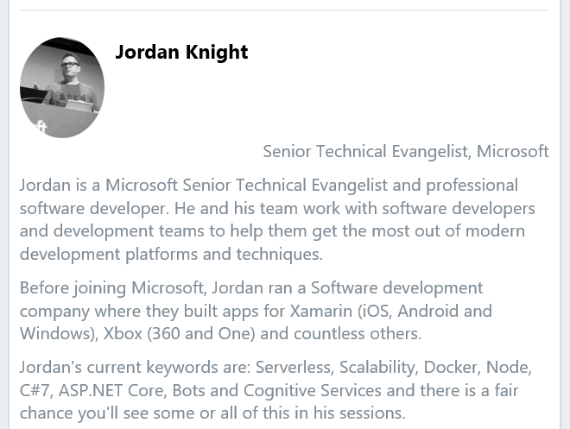
bot talks @ ndc

